Slide 1

Artconnect pro
LESTERLIN Raphaël, DELANNOY Arthur, DONNAT Arthur – L3 INT2

Slide 2

Program
Database conception
App architecture with integrated DB objects
challenges

Slide 3
Database conception
How to store the data of an art community app ?

Slide 4
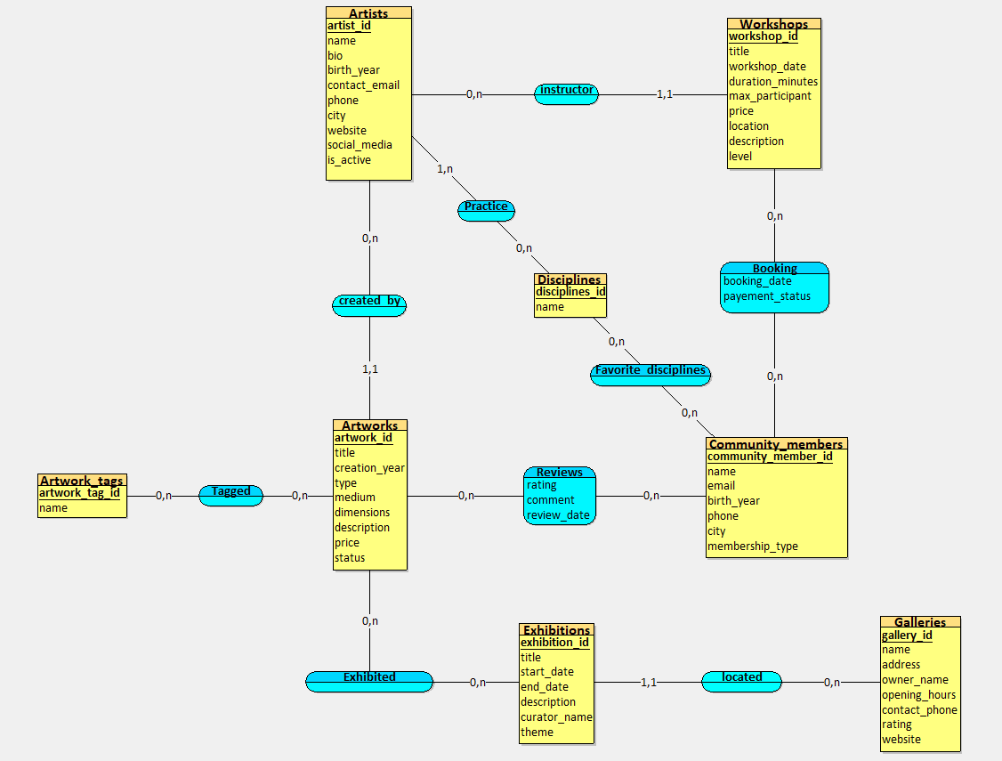
A first glance at relationships
Inspired from the class diagram we make.
However, this is clearly not a normalized database… Especially with relationships containing attached data

Slide 5
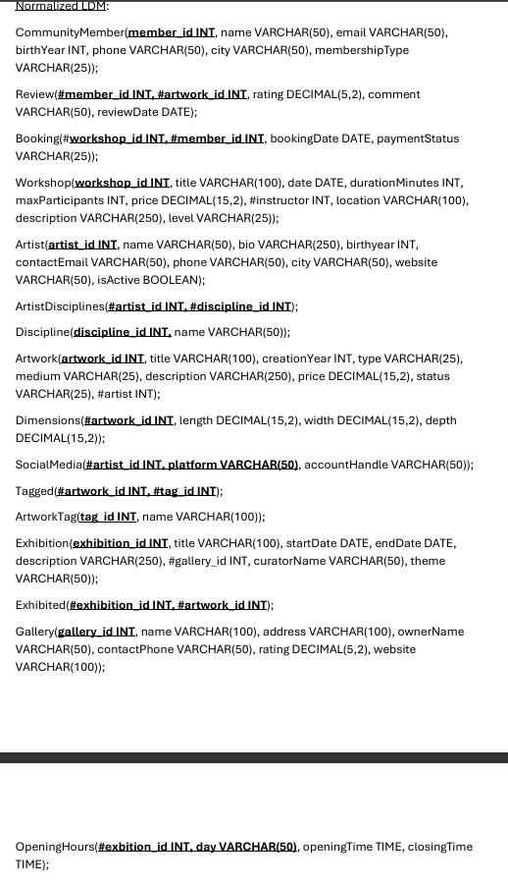

Normalization in LDM
Social Media, opening hours and dimensions didn’t respect 1 NF, they were put in a separate table linked to their former table with a foreign key.
2NF was mostly done with the unique ID keys present.
3NF was completed by turning 0,n – 0,n relationships into auxiliary tables, as seen in exhibited, Tagged and Artist Discipline.

Slide 6
APP architecture with integrated db objects
Internal db procedures and integration in java

Slide 7
Db improvement overview
Our improvements to the SQL database consists of 4 indexes, 1 function, 2 stored procedures, 1 transactional procedure, 3 triggers and 4 views.
The 4 indexes essentially consist in adding a few rows to the index, enough to give more easy identification information for the database and a possible user.
Functions and procedures essentially retrieve data about artworks, looking if an artwork is exhibited, at what date, and the number of member in a workshop.
The transactional procedure check tries to register a member in two workshops, rollbacking if one of them is full
The views aims to give the user a ready-made access to all the artwork, artist and exhibition data, while giving admins the ability to see all the info about participants to a workshop.

Slide 8
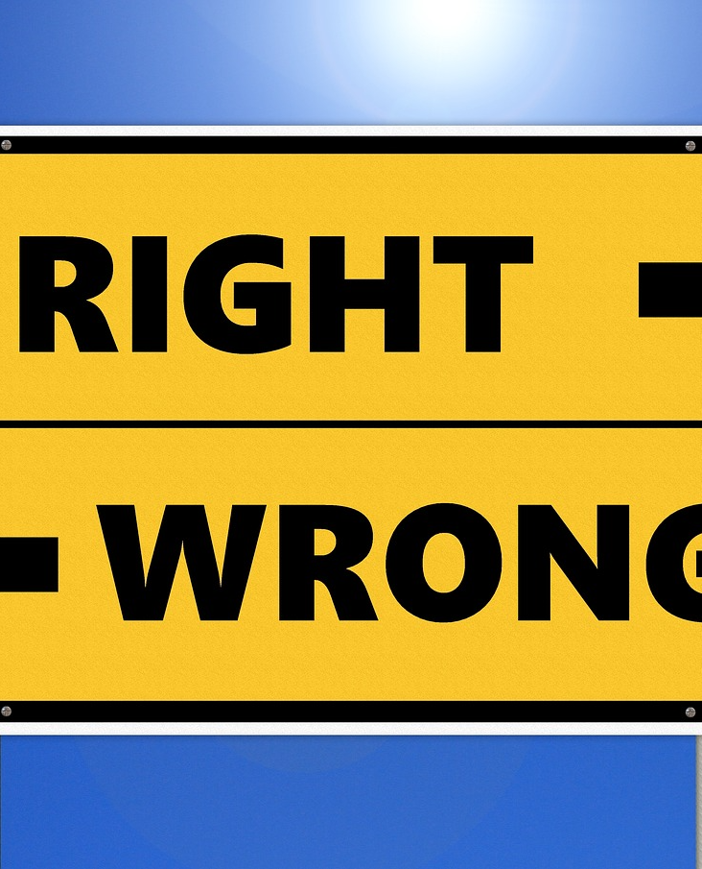
Triggers to keep db safe
Date_Check, ad hoc validation condition that checks if a new record has its end date after its start date;
Artwork_Check, a trigger that verifies if a new artwork was created after the artist’s birth year;
Fully_Booked, a trigger preventing a new booking of a workshop if the maximum amount of participants has been reached.

Slide 9
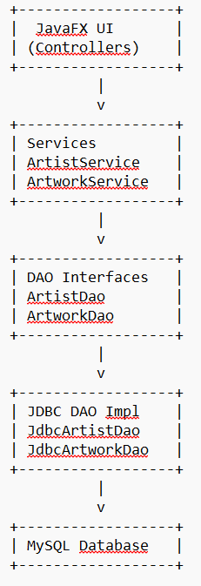
Simplified schema of app architecture

Slide 10

Challenges and other improvements

Slide 11
Learning on the counter a new Stack
Before this project, we weren’t familiar at all with JDBC, outside of some attempts in one of the TP sessions. We had to figure out a bit on ourselves how the different java dependencies worked, to make sure at first that the given template worked correctly once we implemented the DAO interfaces.
Having never developed Java Software Interfaces before, this was also a challenge to develop things that are working, without messing the original program. This needed hours of debugging, research and some LLM help to figure out the problematic points sometime.

Slide 12

Interface Improvements
Added deletion button on individual records inside app, refreshing the UI after deletion (another major challenge)
Added automatic retrieval from tables for former non-1NF conforming fields
Added participant count in UI + Workshop participation in community tab

Slide 13

Future improvements
Add a dedicated tab for reviews
Change artwork status following exhibition updates
Add booking cancelation display in ui
Add + update interface

Slide 14
Thank you for listening
You will find our codebase on the github link in the linked report

